Slide 1
Sanction Letter Retrieval

Slide 2
Process Sanction Letter Retrieval
Opening Script - Welcome to Grihum Housing Finance Limited. My name is (Agent Name) How may I assist you?
Customer - I want Sanction Letter
AI - Please note that this call is being recorded for quality assurance and training purposes.
AI - To verify the information, kindly provide the registered mobile number ( To check the details in finnone slide 3)
AI - Verification - Any 3 of the below verification questions needs to be answered ( To verify the customer details slide 4 )
NAME
Date of Birth
Registered Email ID
Loan Sanction Amount
EMI Amount
AI - Thank you, Sir/Madam. Your verification has been completed.
If there are two LANs, AI should first confirm the specific sanctioned amount, as the LAN number is not recollected. Once confirmed, proceed with the relevant LAN number. Check Point: FinnOne, Slide 4.
AI- As you requested a sanction letter
AI – We will raise the request for the sanction letter within 8 working days. You will receive the sanction letter on your registered email ID. ( To raise the req slide 5 to 14 )
If the Email ID is not available – customer can also visit the branch to collect the Sanction Letter.
AI - Any other details required apart from this?
Thankyou for calling Grihum Housing Finance Limited. Have a pleasant day!

Slide 3
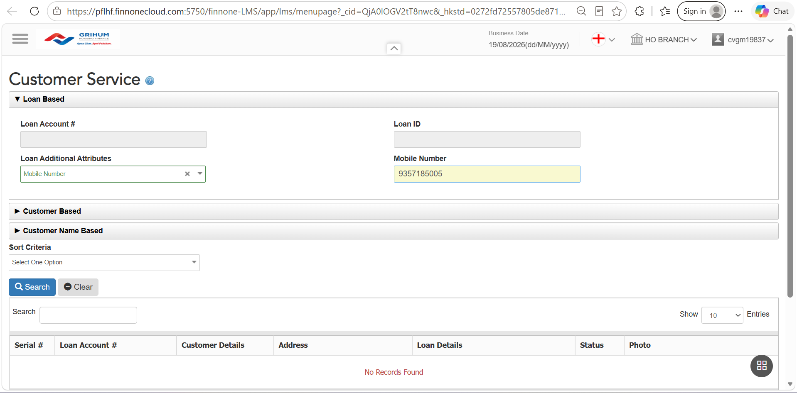
FINONE
To verify the information, please provide the customer's registered mobile number.

Slide 4
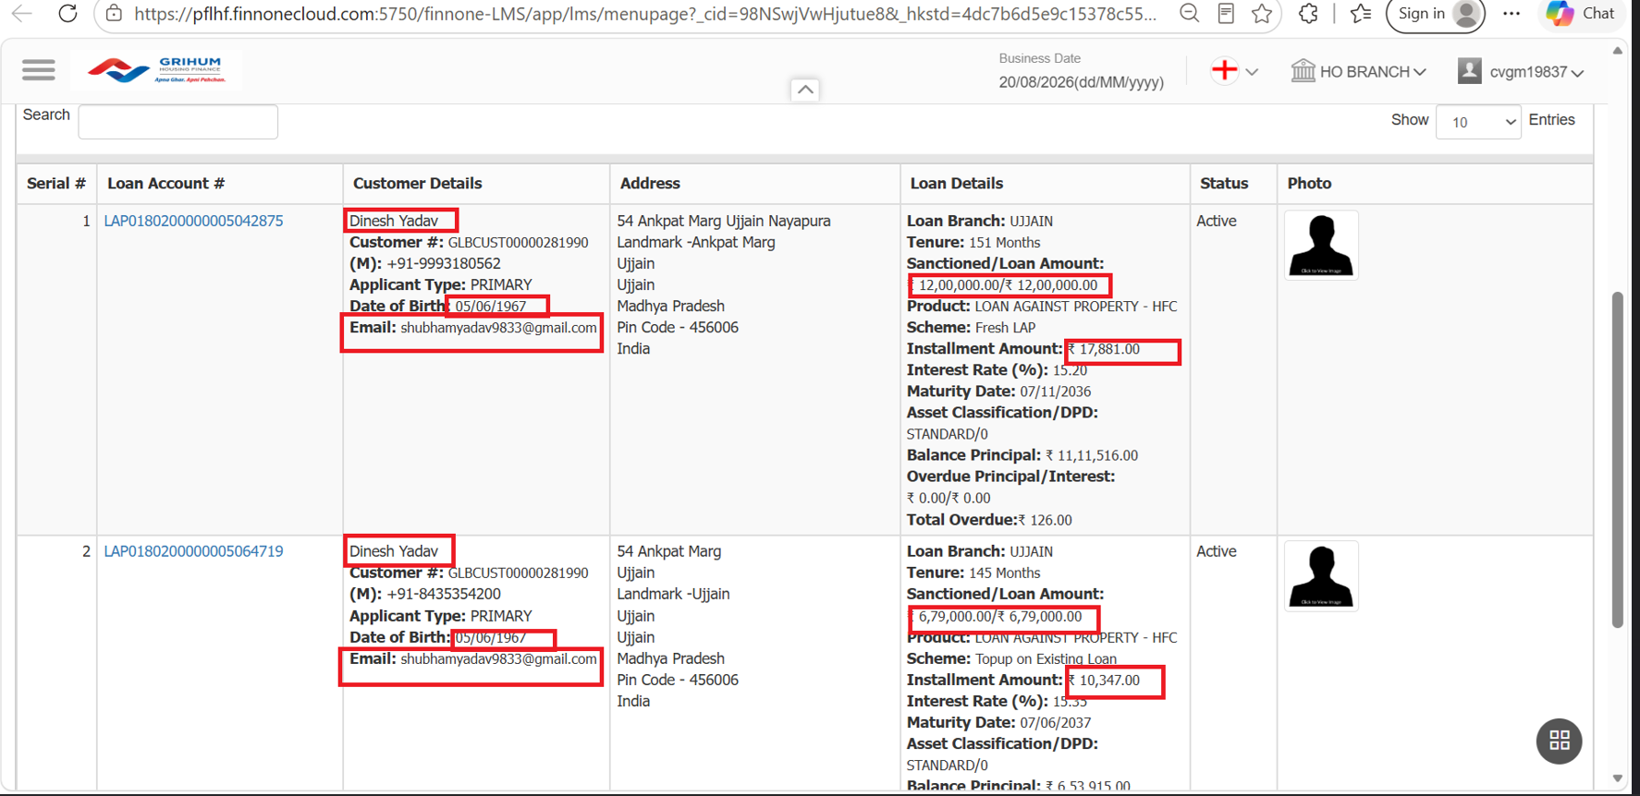
Verification - Any 3 of the below verification questions needs to be answered

Slide 5
CSR Tagging

Slide 6
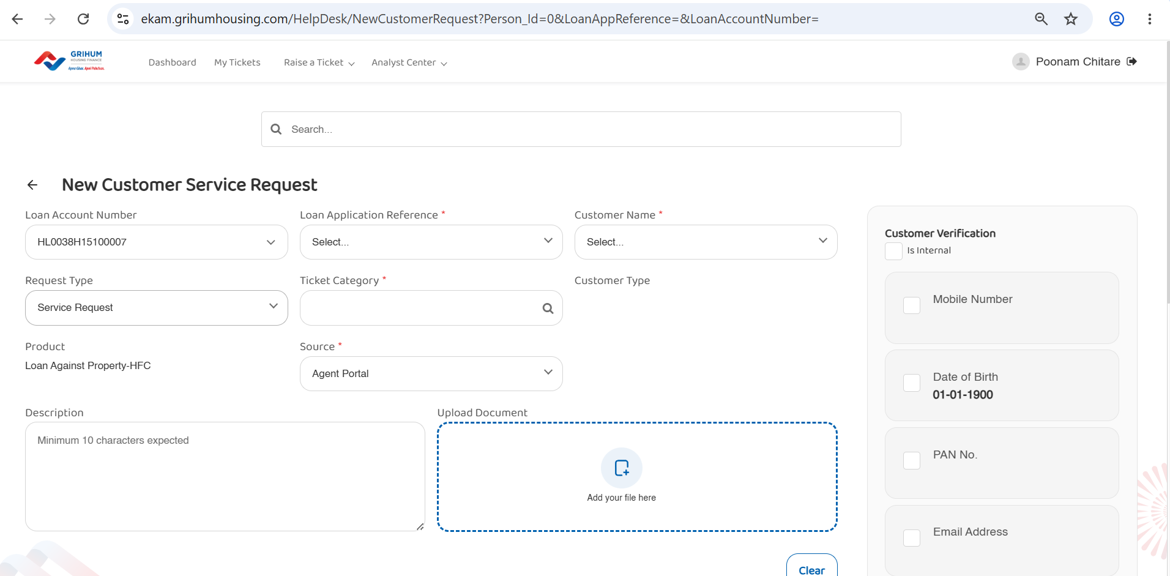

Slide 7
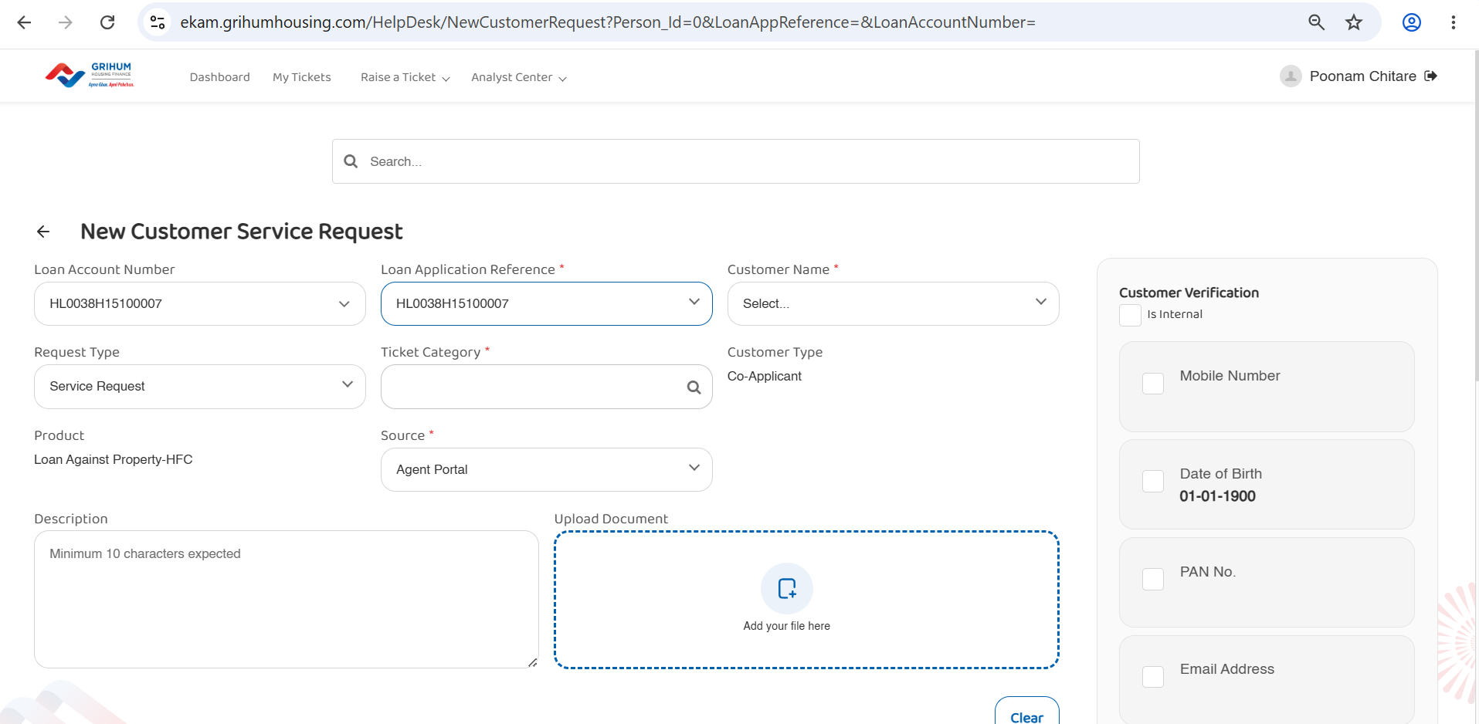

Slide 8
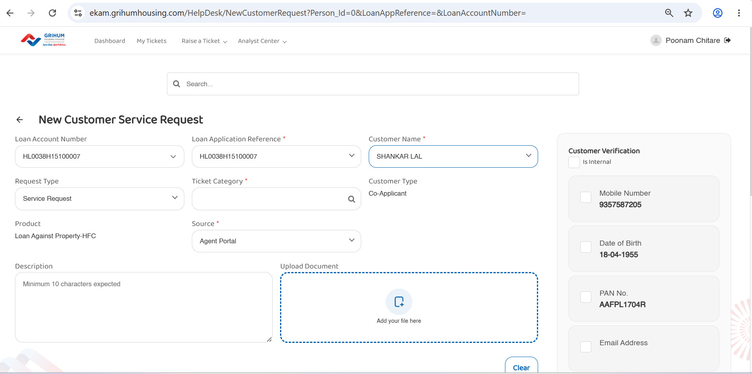

Slide 9
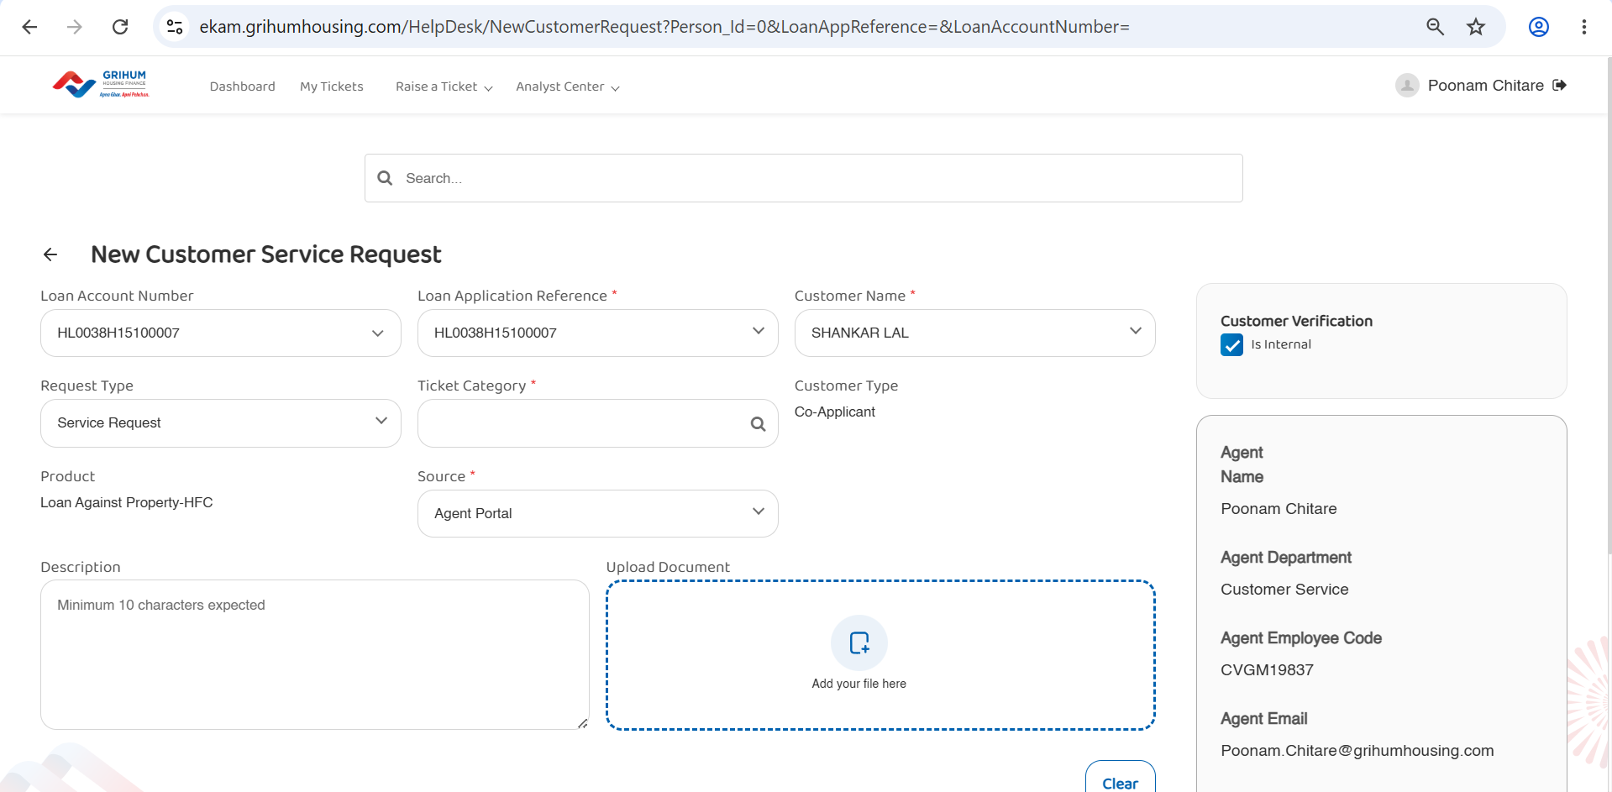

Slide 10
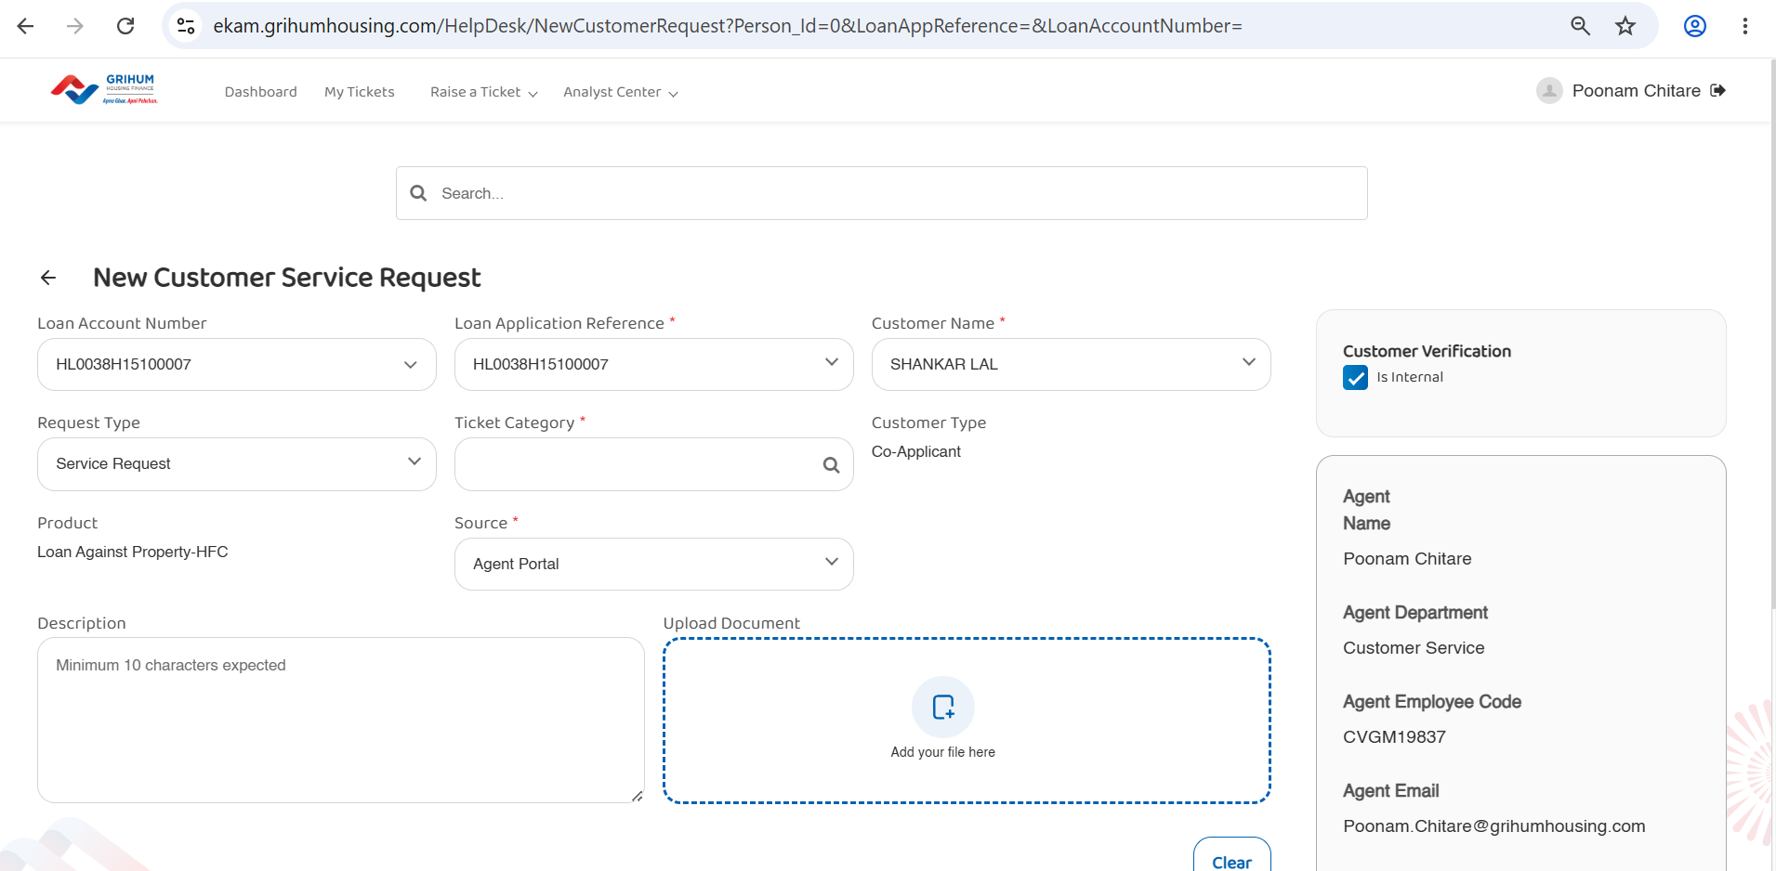

Slide 11
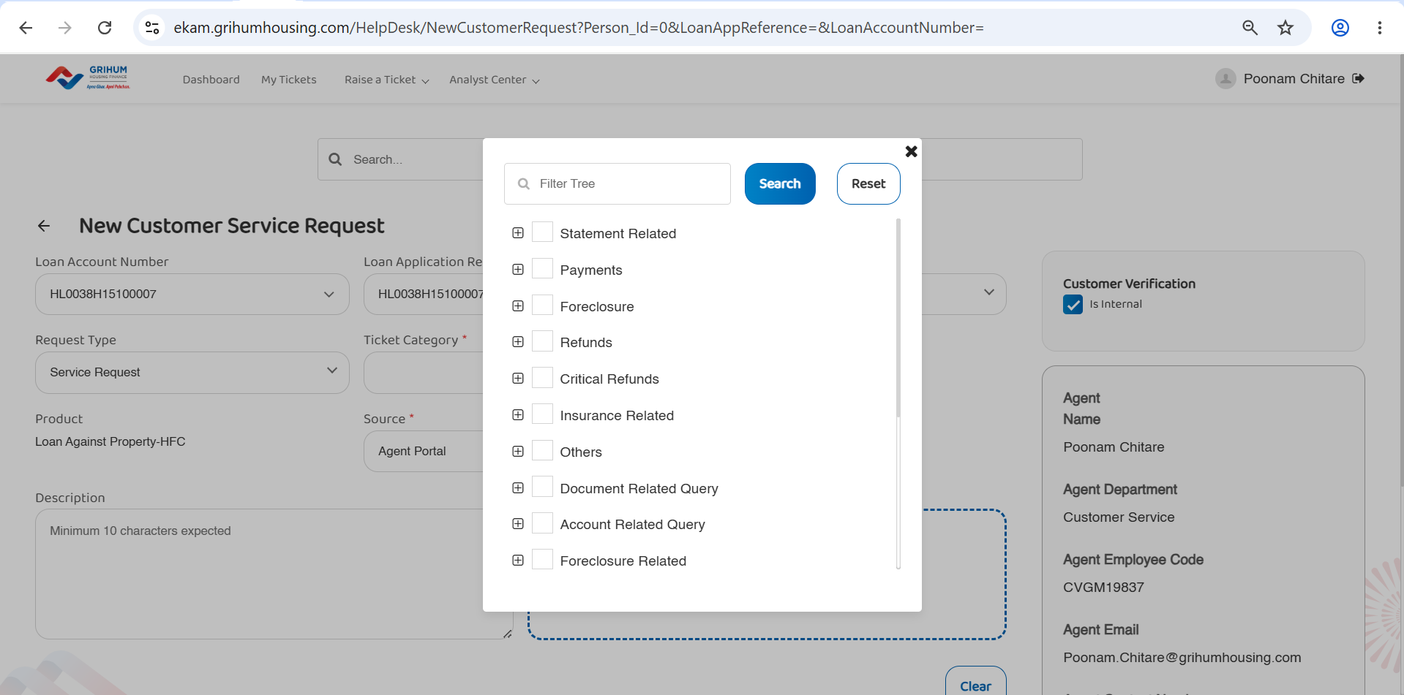

Slide 12
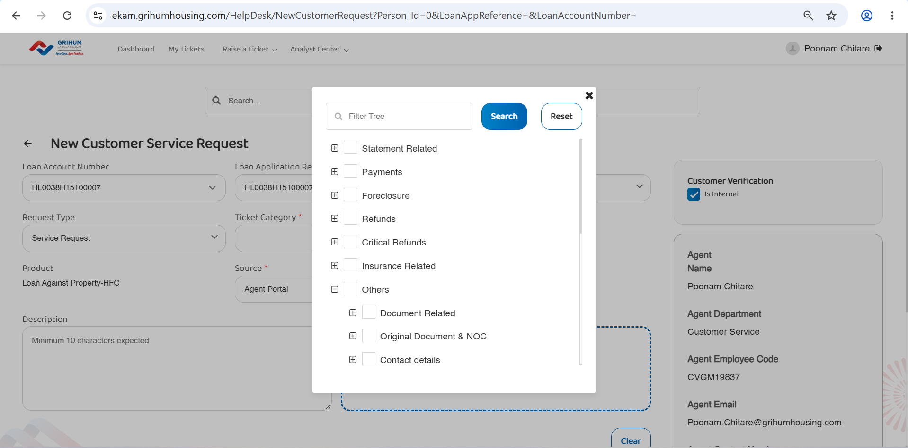

Slide 13
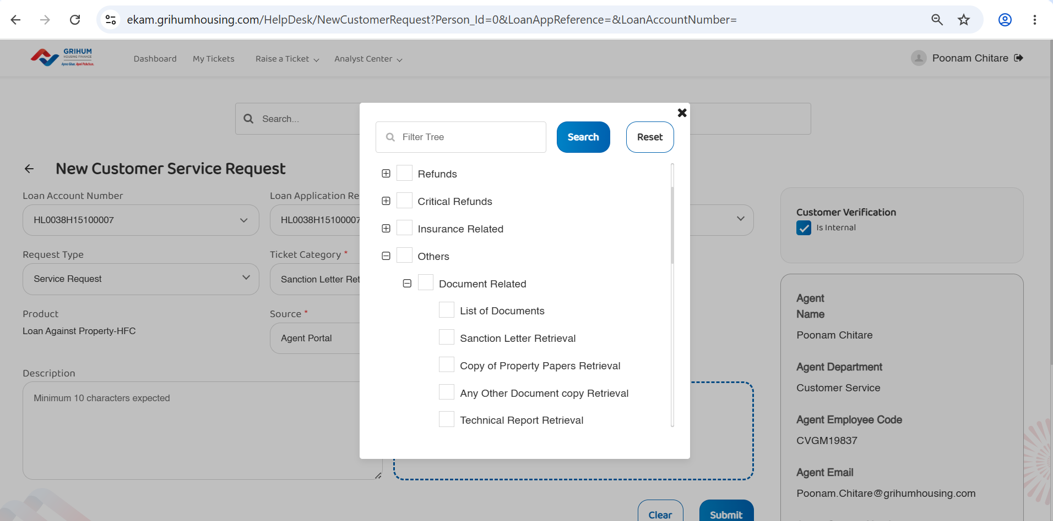

Slide 14
